Slide 1

Water monitoring and pump controller
Bachelor In Information Technology (BIT) III Semester
Bhavishek Lama
Prasant Khadka
Sulav Acharya

Slide 2
Agenda
Introduction
Objectives
Platform
Conclusion
Features
Problem Statement
Hardware Components
Block Diagram
Proteus Simulation

Slide 3
Introduction
Designed for Smart water automation system using 8051 microcontroller.
Automatically controls motor based on tank water levels.
Sends SMS alerts or efficient, reliable, and automated household water management.

Slide 4
Problem Statement
To design a smart system that automatically manage water levels between two tanks using sensors and 8051 microcontroller, ensuring efficient usage and user alerts.

Slide 5
Objective
Improving efficiency
Ensuring a Stable water supply
Reducing water wastage
Minimizing manual effort
To alert when there is activity in a motor

Slide 6
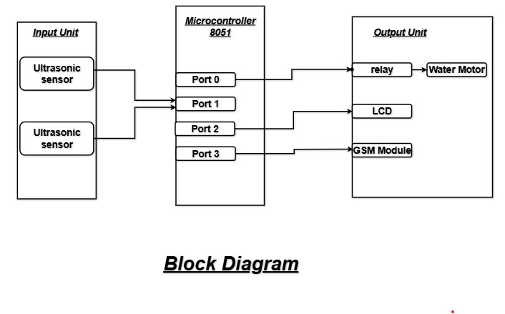
Block Diagram:

Slide 7
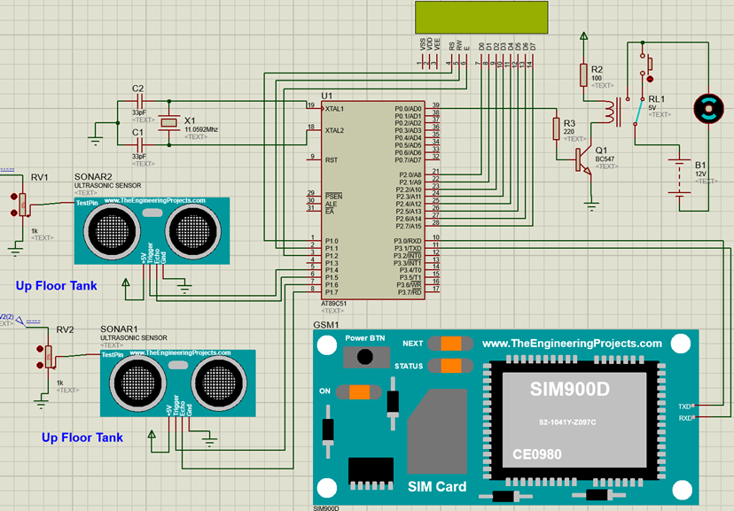
Proteus simulation:

Slide 8
Ultrasonic Water Level Detection
Accurately measures water levels in Tank 1 and Tank 2 using ultrasonic sensors.
Automatic Motor Control
Motor turns ON/OFF automatically based on water levels to maintain balance.
LCD Display Interface
Real-time display of tank water levels and motor status on an LCD screen.
Features

Slide 9
SMS Notifications:
Sends alerts when motor is ON/OFF or maintenance is required, using the SIM800L module.
Smart Water Management:
Ensures efficient and automatic monitoring of both tanks, reducing manual intervention.
Features

Slide 10
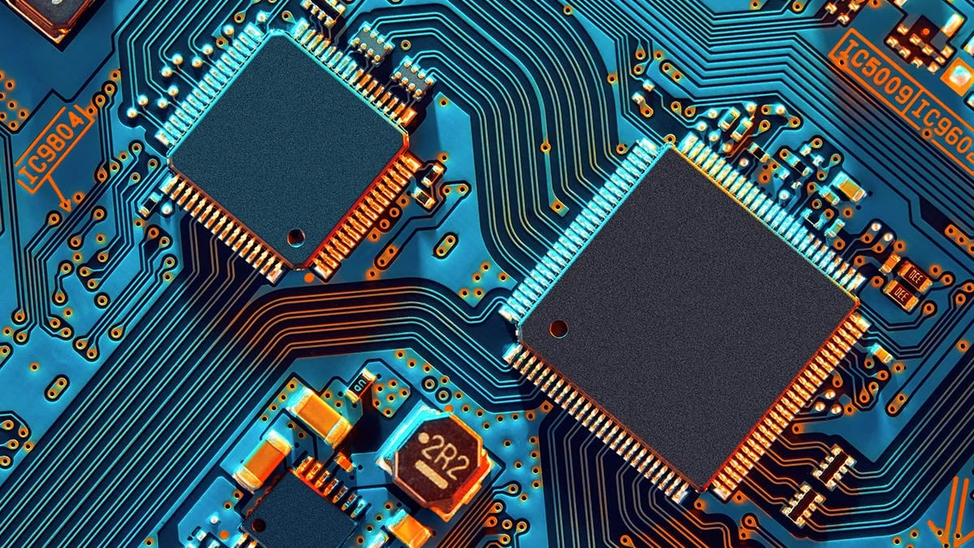
Hardware Requirements

Slide 11
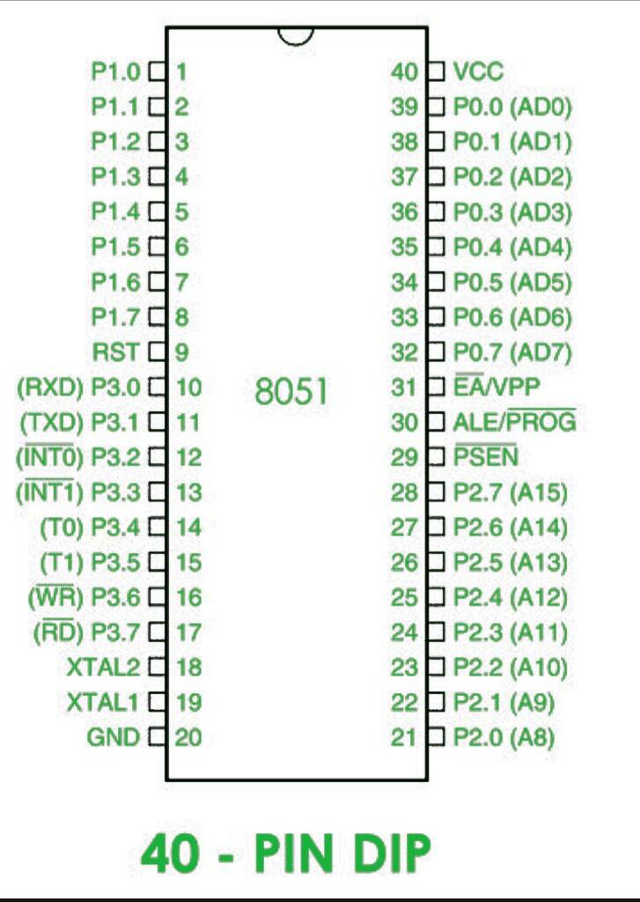
Microcontroller 8051
The 8051 microcontroller serves as the central processing unit, managing input, output from the water level monitoring and pump controller system and controlling the system’s response.

Slide 12
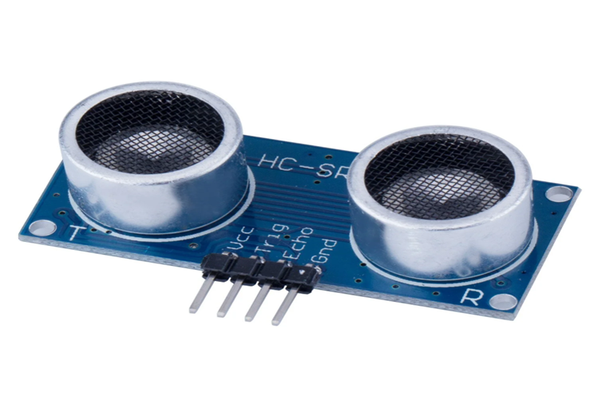
Ultrasonic Sensor:
The ultrasonic sensor functions as the primary distance-measuring device, detecting the water level by sending and receiving sound waves. It provides accurate input data to the system about the water levels in each tank.

Slide 13
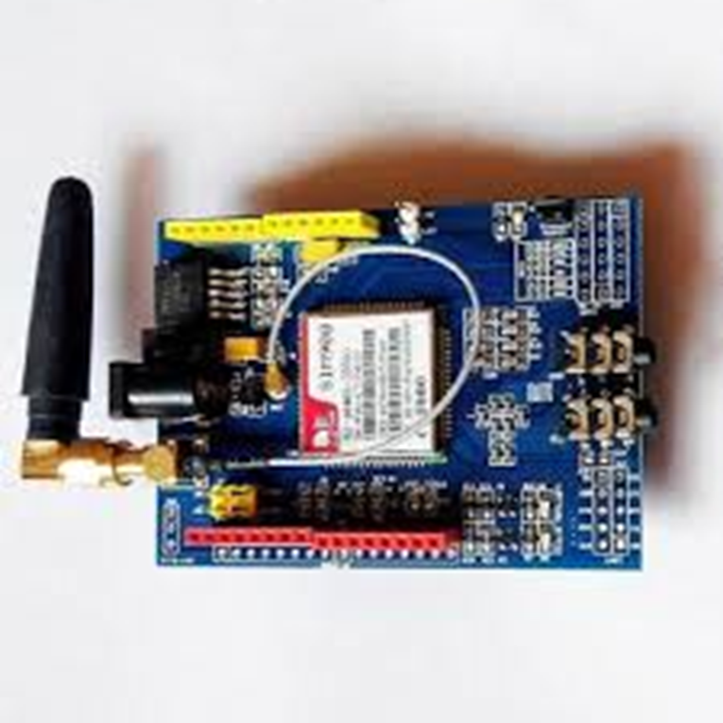
GSM Module
The GSM module sends an SMS alert to a stored phone number when the motor ON/OFF.

Slide 14
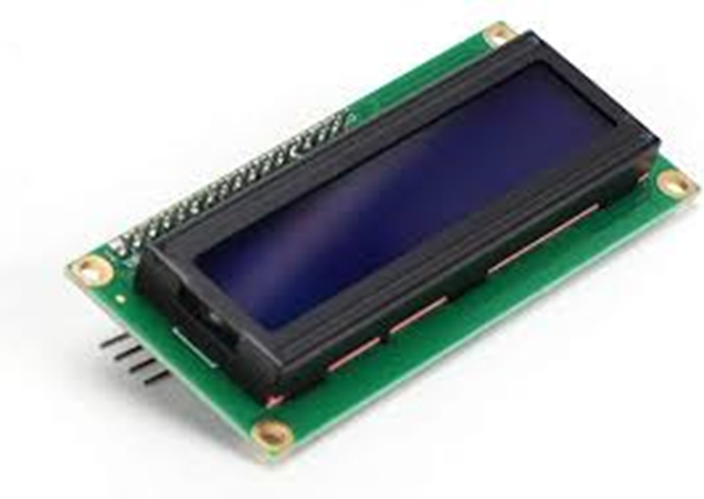
16x2 LCD
The LCD displays system messages, and status updates related to the water level monitoring and pump controller system.

Slide 15
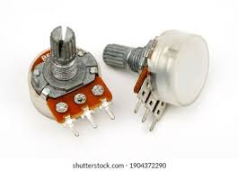
Potentiometer
Adjust voltage manually
It allows manual adjustment of contrast so characters are clearly visible.
Water monitoring and pump controller

Slide 16
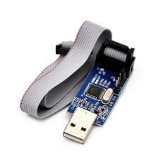
USB Programmer
Allows to upload (flash) your program (hex file) into the microcontroller.

Slide 17
Use an 8051 development board
Keil µVision for programming.
Platform

Slide 18
Conclusion
This 8051-based water supply system automates water level monitoring and pump control via SMS, improving efficiency and reliability.

Slide 19
THANK YOU!!

